Slide 1
Open-Channel SSD
BAI Shuhan

Slide 2
Why we need
Open-Channel SSD?

Slide 3
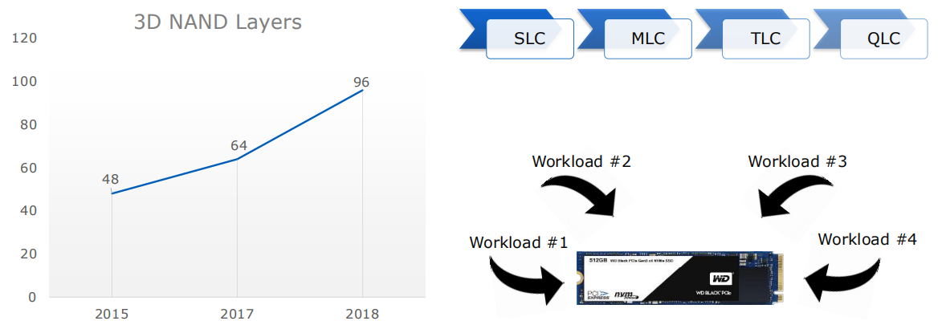
NAND Chip Density Continues to Grow While Cost/GB decreases
more bits inside one cell
more layers
lower R/W speed
shorter SSD lifespan
more need for FTL
optimization

Slide 4
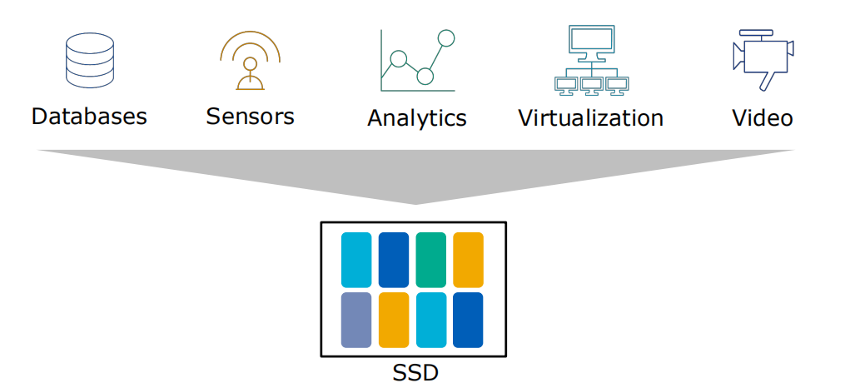
Ubiquitous Workloads Efficiency of the Cloud requires many different workloads of a single SSD
cannot guarantee IO isolation
nowaday general SSD's FTL is decided by firmware, lose flexibility
nowaday general SSD's FTL cannot be suitable for different kinds of workloads
Unable to realize SSD's full potential

Slide 5
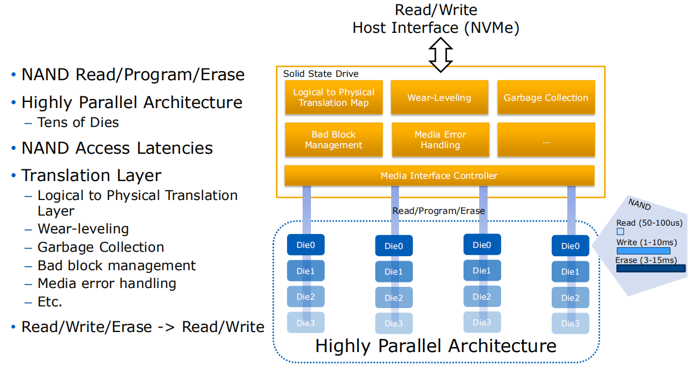
Single-User Workloads 'blackbox' abstraction causes unpredictable IO latency and tail latency
FTL inside 'blackbox' causes unpredictable IO latency
(conflict between foreground user IO and background GC IO)

Slide 6
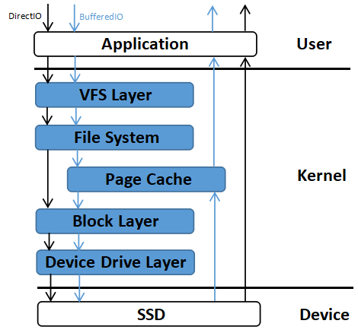
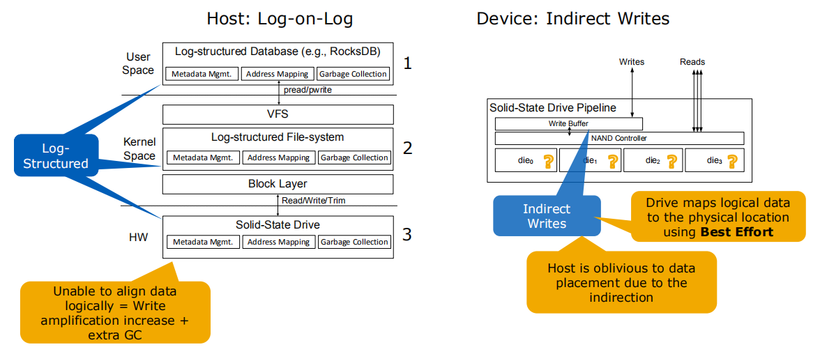
Single-User Workloads Indirection and Indirect Writes causes outliers
further causes the SSD
lifetime degradation
semantic gaps between
host and device
cannot fully use SSD's
internal parallelism

Slide 7
Motivations
General FTL cannot satisfies various kinds of workloads
Isolation between different user IOs cannot be guarantee
Device-side FTL causes unpredictable IO latency
Functional redundancy → WA → lifetime degradation
Device-side FTL causes semantic gaps and users cannot fully use SSD's internal parallelism
Open-Channel SSD

Slide 8
What is
Open-Channel SSD?

Slide 9
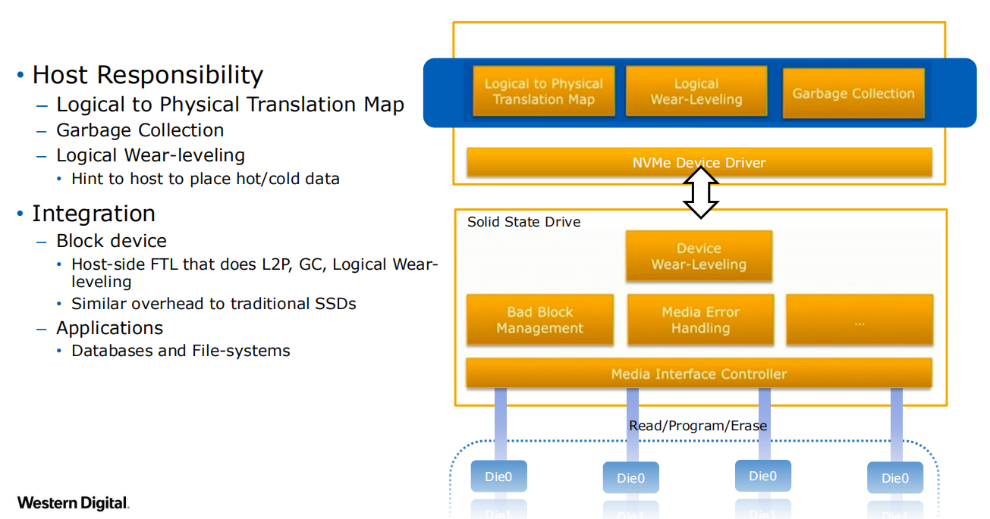
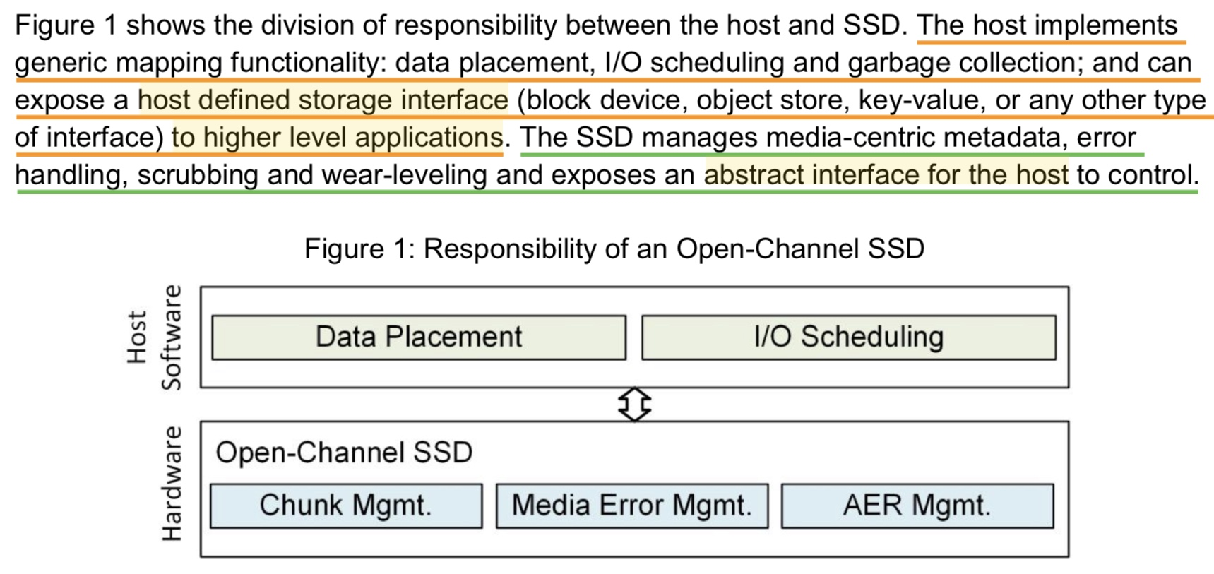
Open-Channel SSD Internals

Slide 10
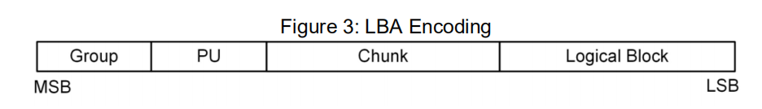

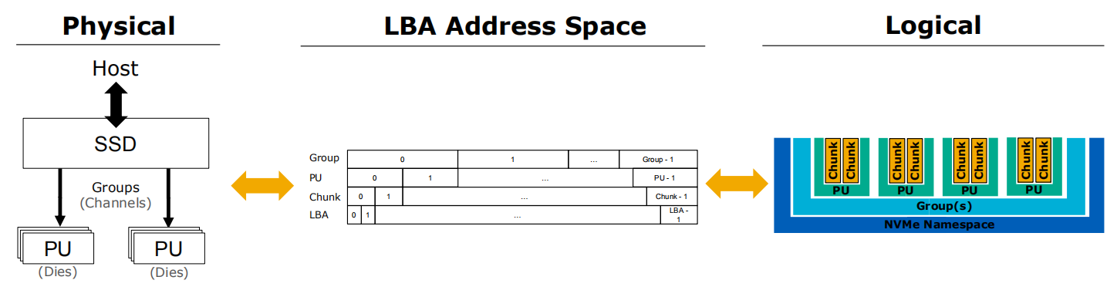
Open-Channel SSD Representation
Just a logical representation!

Slide 11
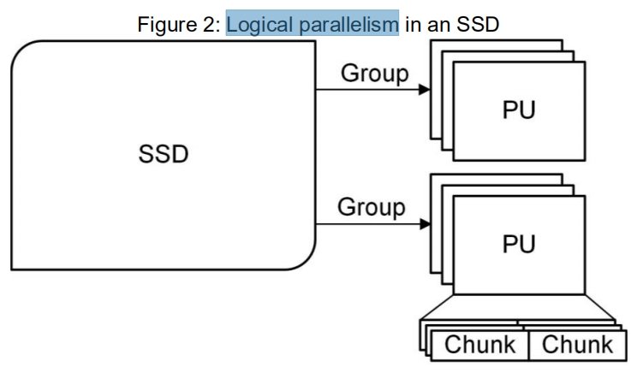
Open-Channel SSD Representation
Group: a set of PUs that share the same transfer bus. (Channel)
PU (Parallel Unit): the unit of parallelism within the SSD, and its access is fully independent of other parallel units. (a (set of) Die(s))
Chunk: a set of contiguous logical blocks. The logical blocks shall be written sequentially within the chunk. A chunk is the smallest range of logical blocks that can be reset as a unit. (a (set of) Block(s)) (minimum erase size)
Logical Block: the smallest addressable data unit for Read and Write commands. This takes on the meaning from the NVMe specification, and does not represent a physical flash block. (LBA) (minimum read size) (a (set of) Page(s))
Write Unit: the smallest number of logical blocks that shall be written at a time. (minimum write size)

Slide 12
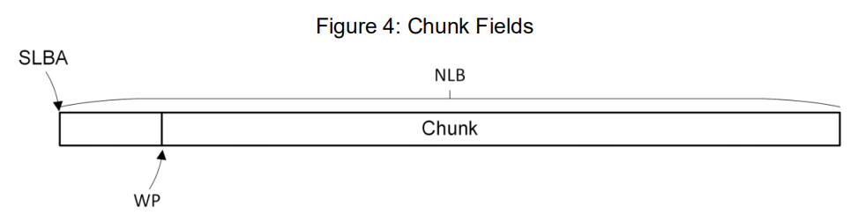
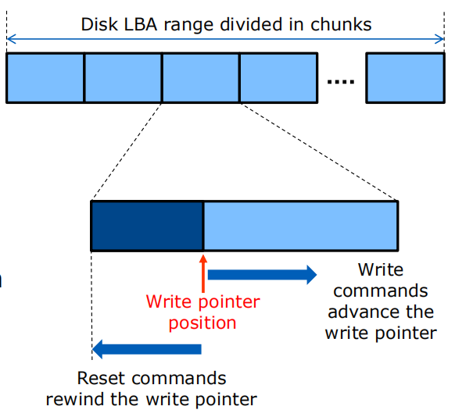
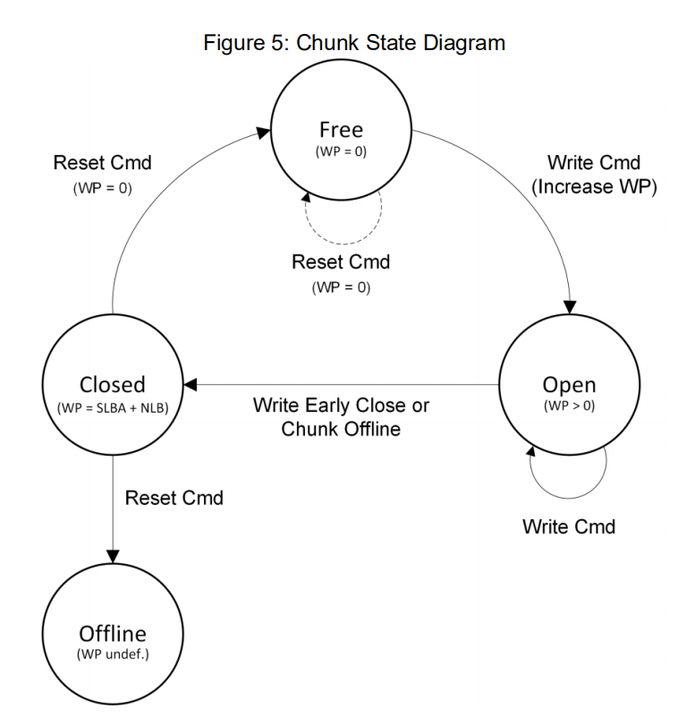
Chunks
(start LAB)
(number of logical blocks)
(write pointer)
(cs)

Slide 13
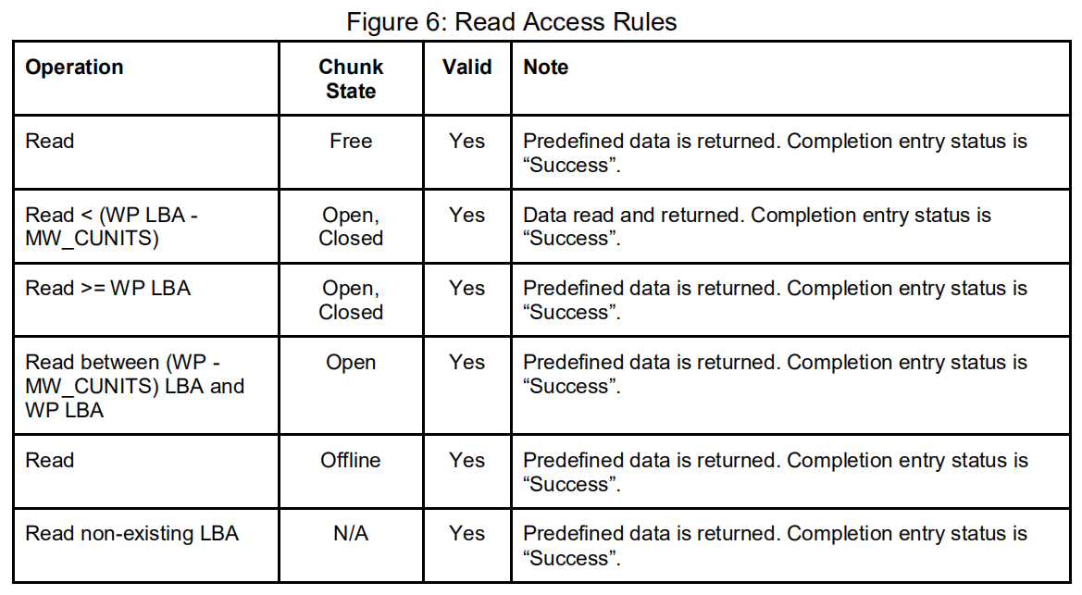
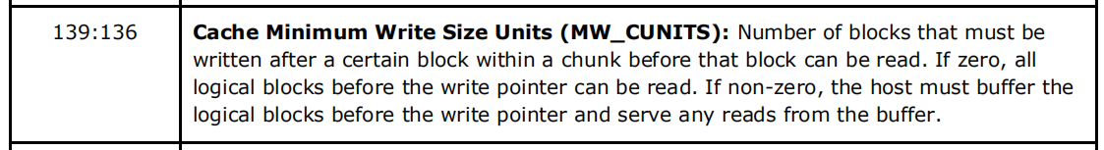
Read Access Rules
all reads are valid to the controller
If data is not available, the data to be returned are predefined by the Deallocate Logical Block Features (DLFEAT) field in the NVMe 1.3 Identify NVM Command Set data structure.
(Device Geometry Data Structure - Write Data Requirements)

Slide 14
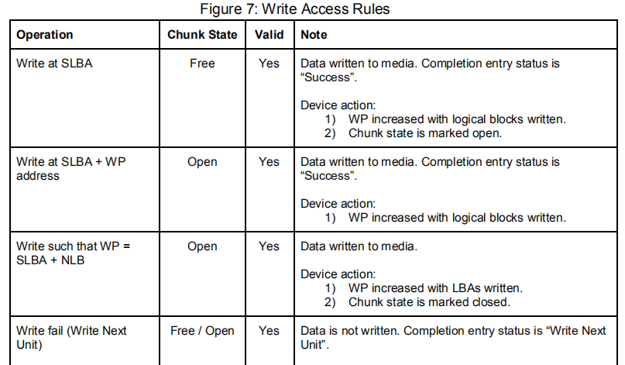
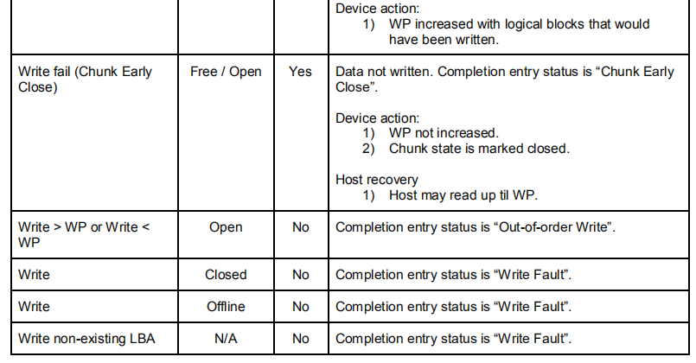
Write Access Rules
the writes to the chunk must be sequential

Slide 15
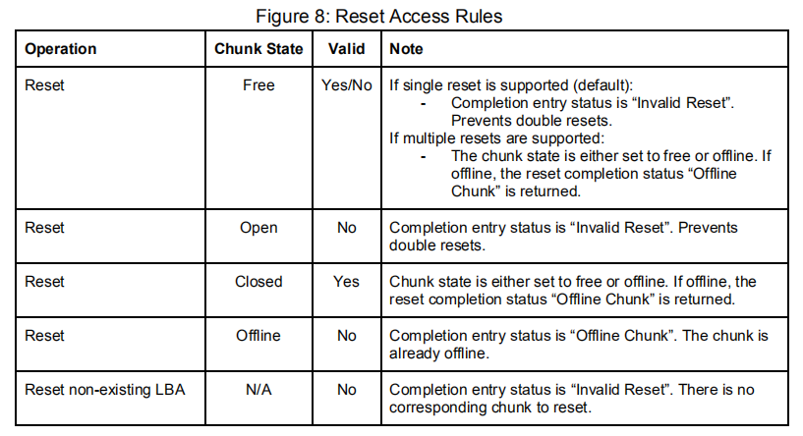
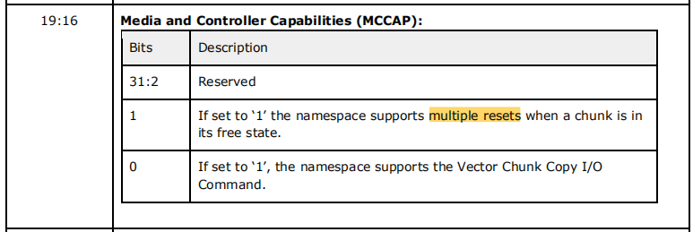
Reset Access Rules
“closed”and“free” chunk can be reseted
after reset, the chunk state is either set to “free” or “offline”
(Device Geometry Data Structure)

Slide 16
How to implement
Open-Channel SSD?

Slide 17
Physical Page Addressing Command Set
Physical Page Addressing Command Set consists of Admin and I/O commands.
Admin commands are used to communicate the geometry of the device and chunk state.
I/O commands are used to read, write and copy data, and reset chunks.
All commands conform to the regular NVMe command structure.

Slide 18
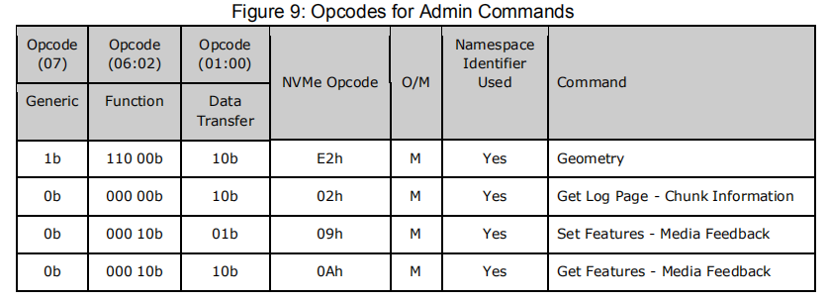
PPA Command Set - Admin Commands

Slide 19
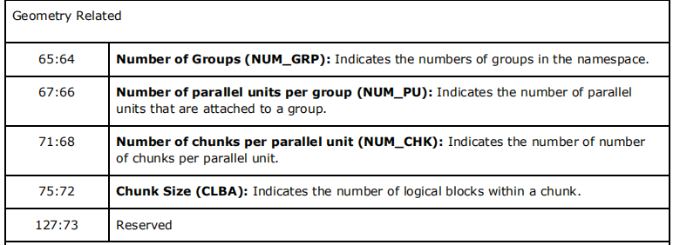
Admin Commands - Geometry
On success, the data structure defined in Figure 11 is returned.

Slide 20
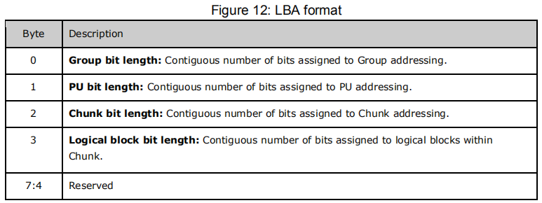
Admin Commands - Geometry
On success, the data structure defined in Figure 11 is returned.
As an example, assume the following configuration:
● 16 groups - 4 bits required. Bits 27-24 specify a group. Bits 63-28 are unused.
● 4 PUs within each group - 2 bits required. Bits 23-22 specify a PU within a group
● 1004 chunks within each PU - 10 bits required - Max 1024.
Bits 21-12 specify a chunk within a PU
● 4096 logical blocks within a chunk. 12 bits required.
Bits 11-0 specify a logical block within a chunk.

Slide 21
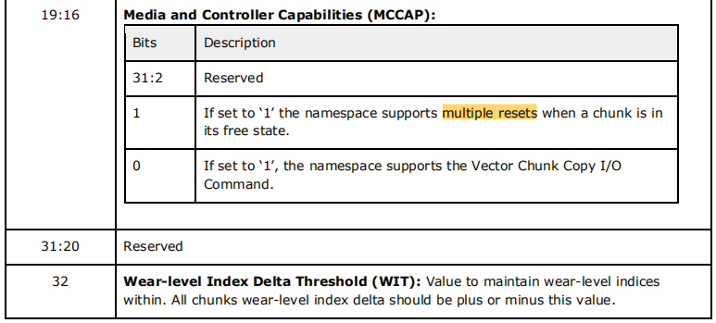
Admin Commands - Geometry
On success, the data structure defined in Figure 11 is returned.

Slide 22
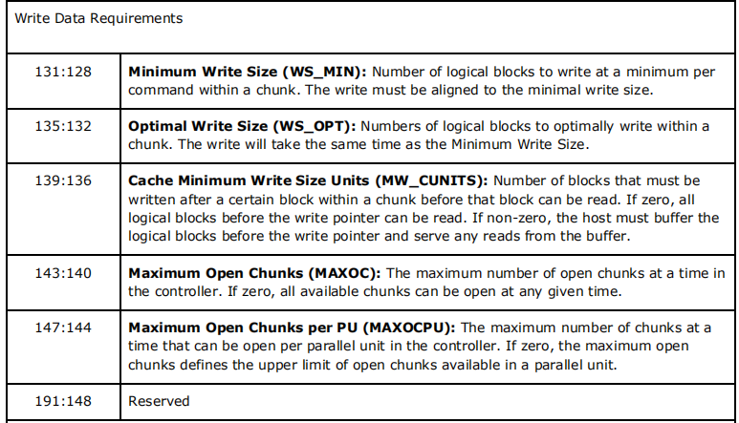
Admin Commands - Geometry
On success, the data structure defined in Figure 11 is returned.

Slide 23
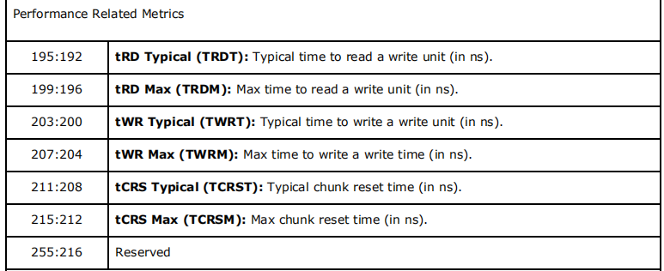
Admin Commands - Geometry
On success, the data structure defined in Figure 11 is returned.

Slide 24
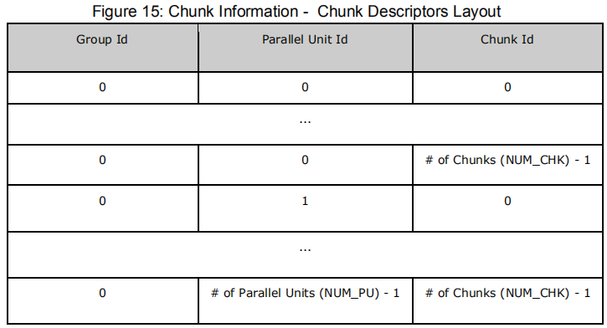
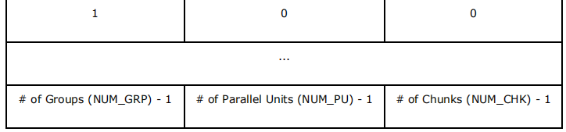
Admin Commands - Get Log Page
Log page store chunk information.
Log page is a list of chunk descriptors, which are laid out sequentially.

Slide 25


Admin Commands - Get Log Page
(Device Geometry Data Structure)
If the geometry command specifies a wear-level index delta threshold, the host should wear-level all chunks evenly, such that the wear-level index for all chunks does not exceed plus or minus the wear-level index delta value across all chunks.Log page is a list of chunk descriptors, which are laid out sequentially.
For example, if the threshold is 10 and the average chunk wear is 100, the wear-level index delta is allowed to be within the range of 90-110.
If host does not wear-level index delta according to the threshold the device may signal it through a Chunk Notification Log event.

Slide 26
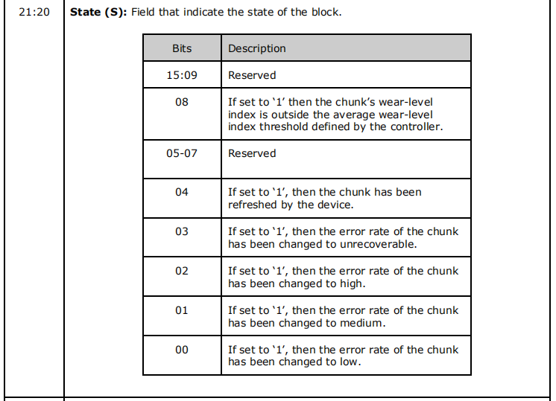
Chunk Notification Log
The feedback mechanism is implemented using the Asynchronous Event Information specified in Section 5.2 of the NVMe 1.3 specification.

Slide 27
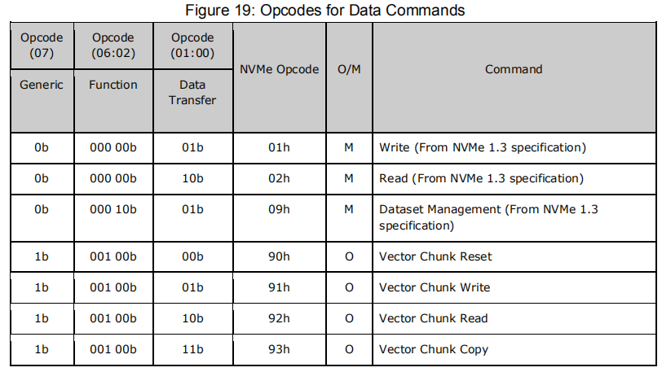
PPA Command Set - IO Commands

Slide 28
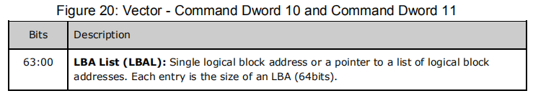
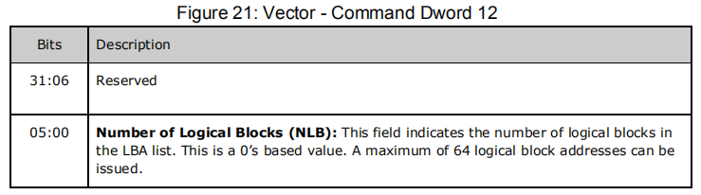
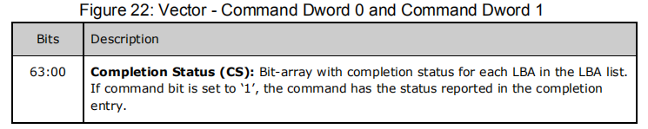
IO Commands - Vector Commands
command submission
command completion

Slide 29
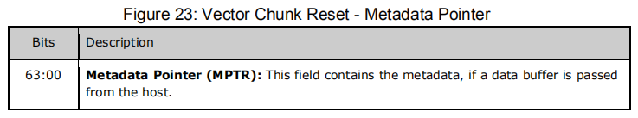
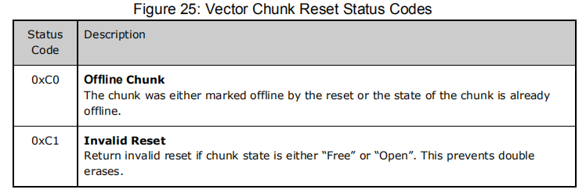
Vector Chunk Reset
command submission
command completion

Slide 30
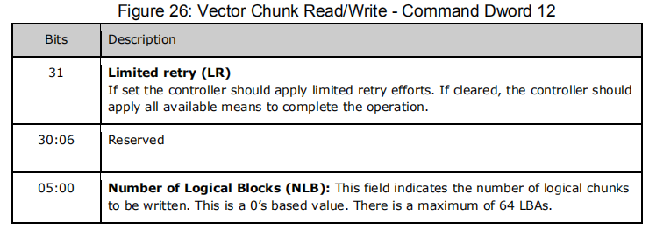
Vector Read/Write
command submission

Slide 31
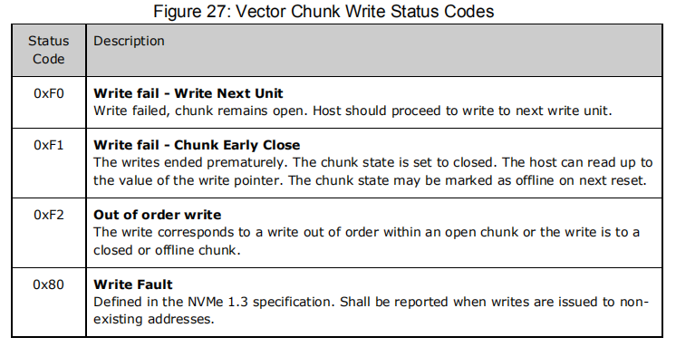
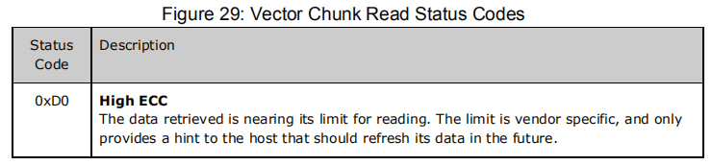
Vector Read/Write
command completion

Slide 32
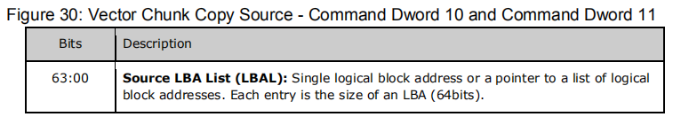
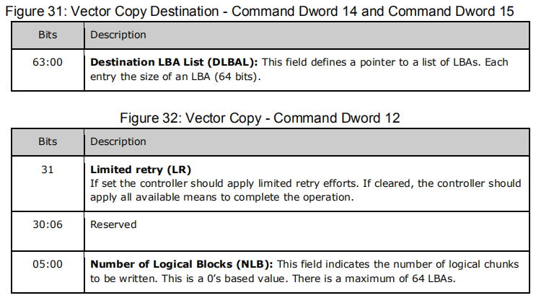
Vector Copy

Slide 33
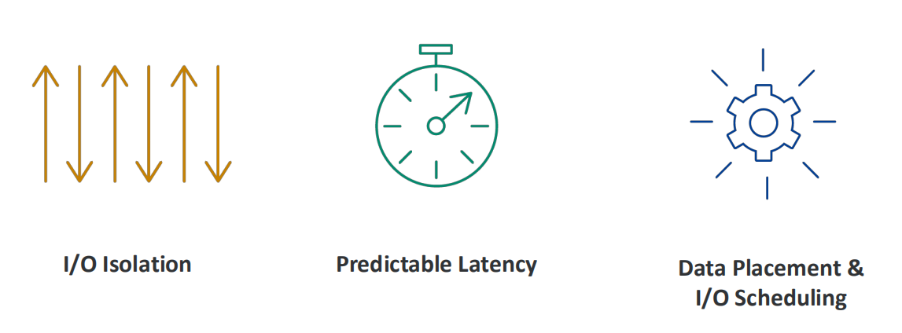
Open-Channel SSD Advantages
application → target → io isolation (PUs are physical isolation, and an Open-Channel SSD exposes a hierarchical representation of its logical blocks, this allows the host to control which parallel unit is accessed independently from other parallel units.)
host controls device management, data placement and IO scheduling → predictable latency
software-defined FTL → higher performance (SSD firmware should not be optimized for any particular workload, as the host will manage access to the parallel units and which chunks are accessed, such that the host can manage the SSD characteristics with respect to parallelism.)

